Slide 1

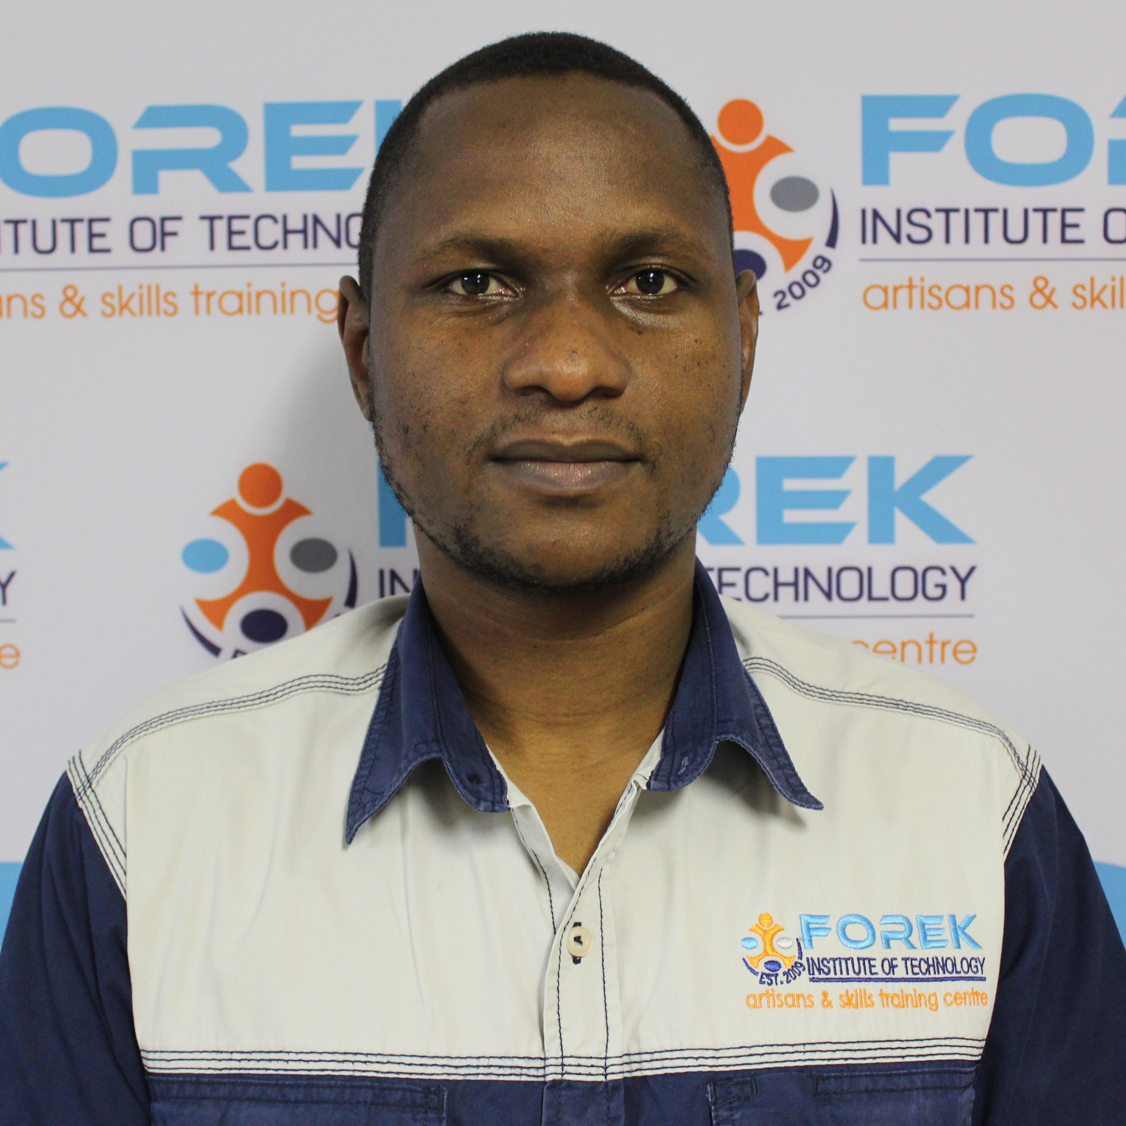
Access card: staff
Mr moses mashaba
Safety
officer

